Slide 2
The future of web standards: from Web Components to WebAssembly
Sergey Pugachev, Google
@spugachev
Notes:
Здравствуйте, меня зовут Сергей Пугачёв. И уже год я работаю в компании Google. Я очень рад, что меня позвали выступить на этой конференции. Быть может это как-то связано с тем, что до Google я более четырёх лет проработал в компании Microsoft. Или не связано, не знаю.
Сегодня я расскажу вам про будущее. Про будущее Web стандартов. Что я имею ввиду? Будущее – это 5, 10, 20 лет вперёд? Нет! Я расскажу о тех технолониях, которые уже могут в каком-то виде использоваться и, на самом деле, активно используются, и которые в ближайший год-полтора станут настоящим мэйнстримом.
Не смотря на то, что моя работа связана напрямую с вебом, всё что я буду рассказывать является моим сугубо личным мнением и может совпадать или не совпадать с мнением моего работодателя.

Slide 3
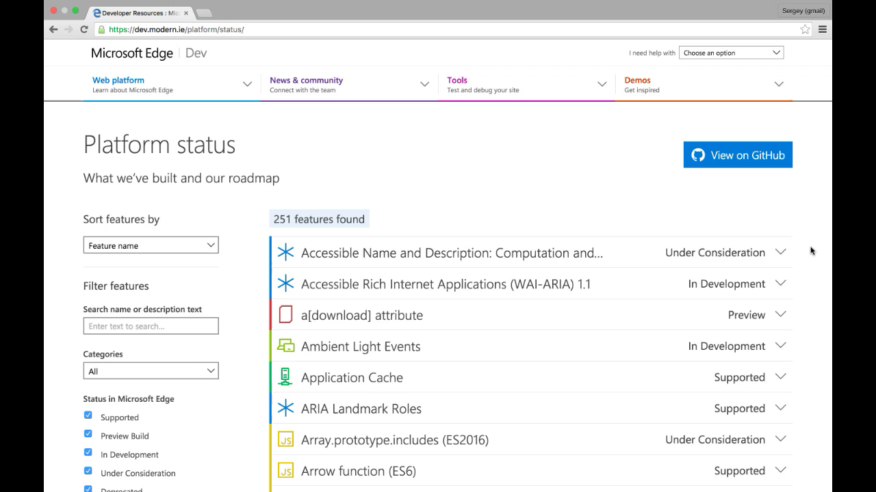

Slide 5
AGENDA
RUNTIME
NETWORKING
USER INTERFACE
HTTP/2
WebRTC/ORTC
EcmaScript 2015 (ES6)
WebAssembly/ASM.js
Web Components

Slide 6
1. NETWORKING

Slide 7

HTTP/1.1
$> telnet spugachev.com 80
Connected to 74.125.xxx.xxx
GET /index.html HTTP/1.1
Host: website.org
User-Agent: Mozilla/5.0 (Macintosh; Intel Mac OS X 10_7_4)... (snip)
Accept: text/html,application/xhtml+xml,application/xml;q=0.9,*/*;q=0.8
Accept-Encoding: gzip,deflate,sdch
Accept-Language: en-US,en;q=0.8
HTTP/1.1 200 OK
Connection: keep-alive
Transfer-Encoding: chunked
Server: nginx/1.0.11
Content-Type: text/html; charset=utf-8
Expires: Wed, 25 Jul 2012 20:23:35 GMT
Cache-Control: max-age=0, no-cache
100
<!doctype html>
HTTP 1.1 ships as RFC standard in 1999
Notes:
NOTE: Stress that this is an industry standard (MRC).

Slide 8
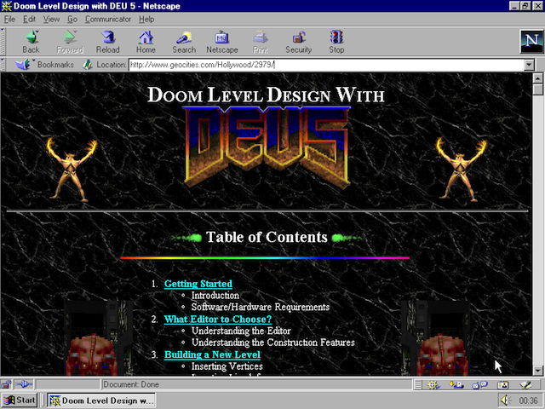
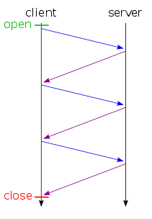
HTTP/1.1 – 1999. 15 (!) years ago
Limited parallelism (~6)
Client-side request queuing
High protocol overhead
~800 bytes + cookies
Competing TCP flows
Handshake overhead
Slow-start overhead
…
Notes:
NOTE: Stress that this is an industry standard (MRC).

Slide 9
"HTTP/2 is a protocol designed for low-latency transport of content over the World Wide Web"
GOAL
Retain the semantic of HTTP/1.1
(methods, status codes etc.)
Improve end-user perceived latency
SOLUTION
Binary protocol with HEADER compression
Minimize number of TCP connections & multiplexing

Slide 10
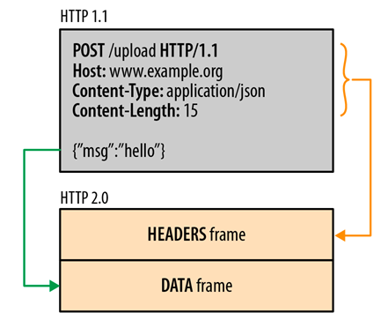
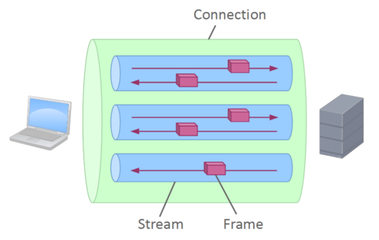
HTTP/2: ONE CONNECTION
Notes:
NOTE: Stress that this is an industry standard (MRC).

Slide 11
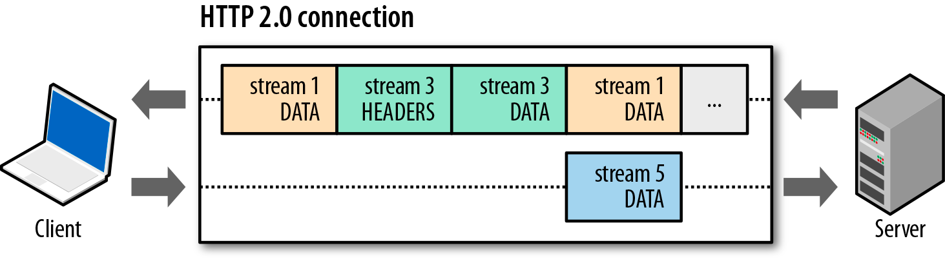
HTTP/2: ONE CONNECTION
Streams are multiplexed by splitting communication into frames
e.g. HEADERS, DATA, etc.
Streams can be prioritized
Streams can be flow controlled
Notes:
Frames are interleaved

Slide 12
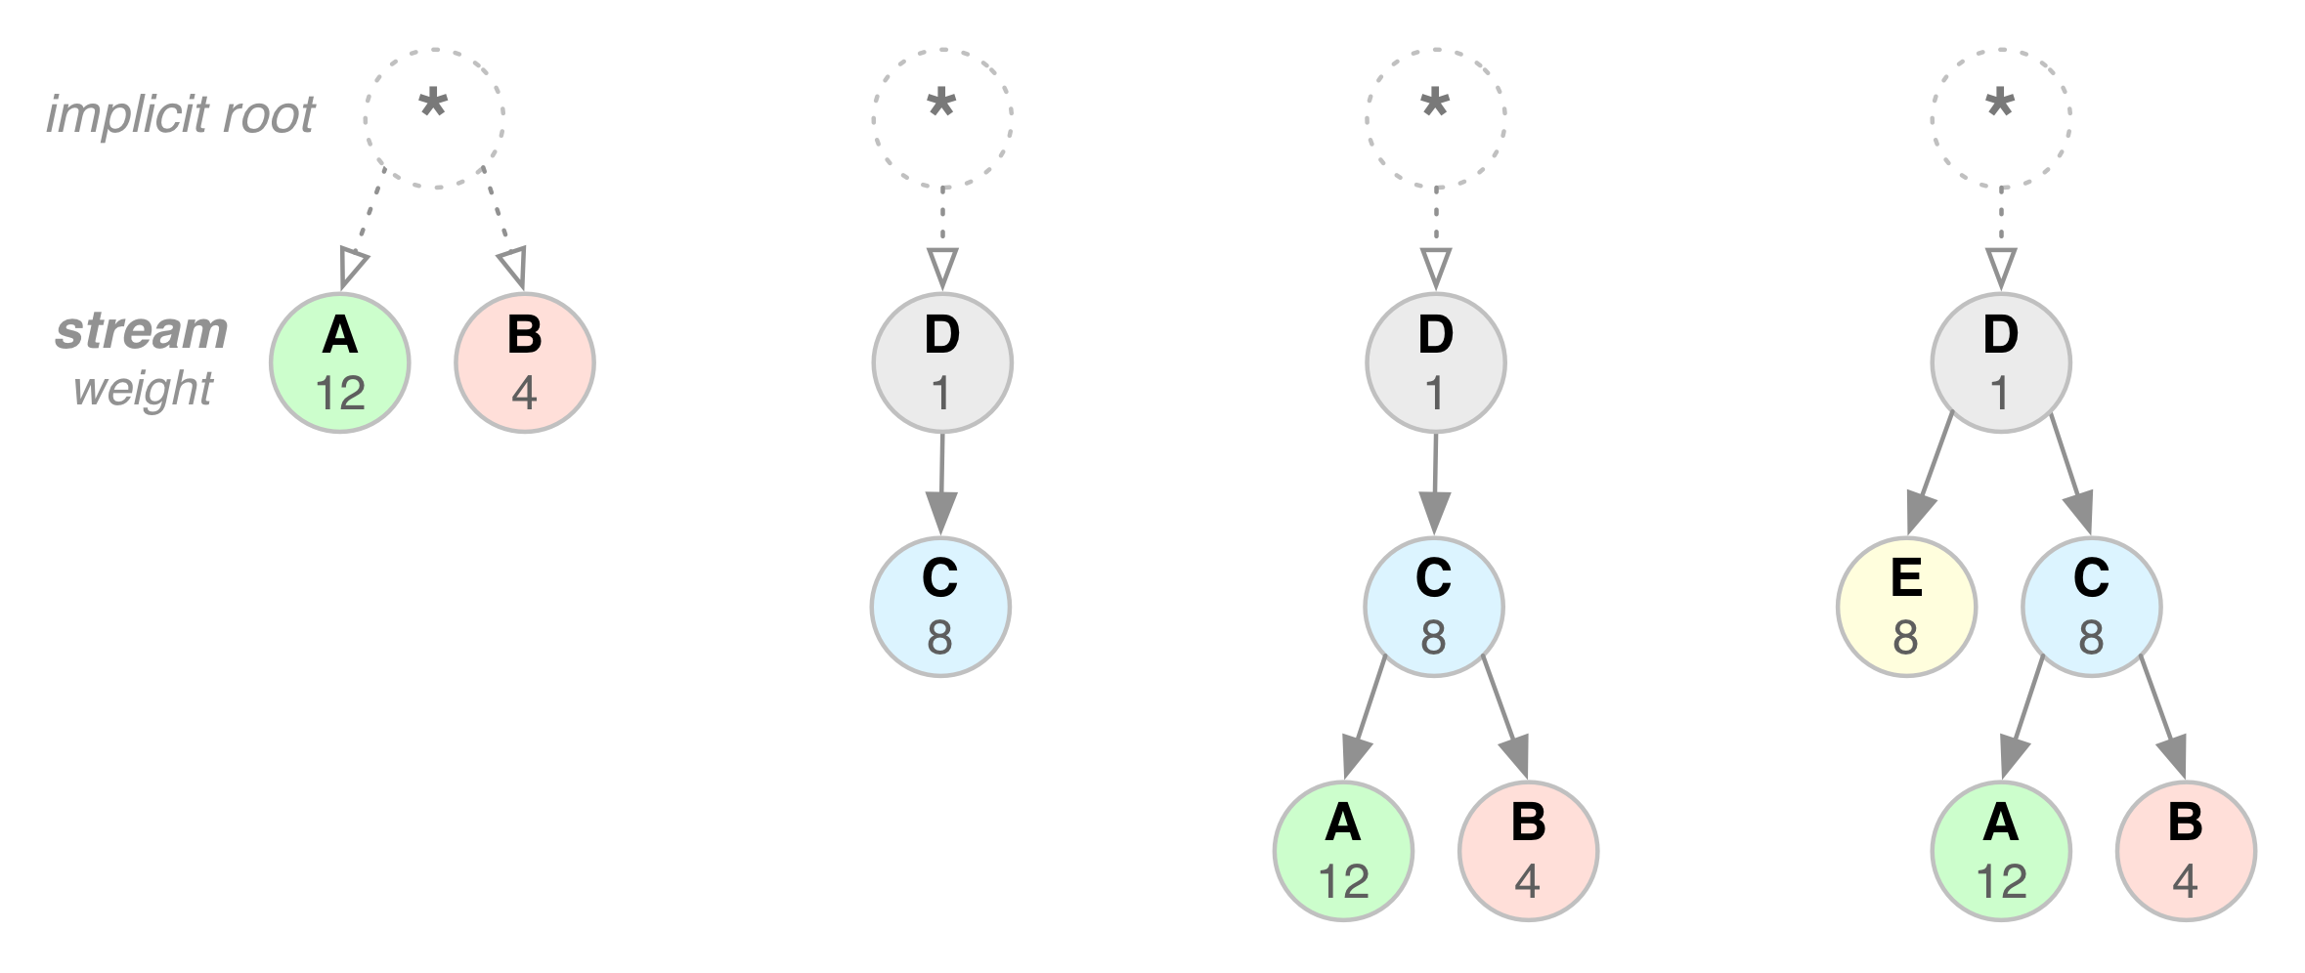
HTTP/2: STREAM WEIGHT & DEPENDENCY
E.g. style.css (“A”) should get 2/3rd’s of available resources as compared to logo.jpg (“B”)
E.g. product-photo-1.jpg (“D”) should be delivered before product-photo-2.jpg (“C”)
Notes:
NOTE: Stress that this is an industry standard (MRC).

Slide 13
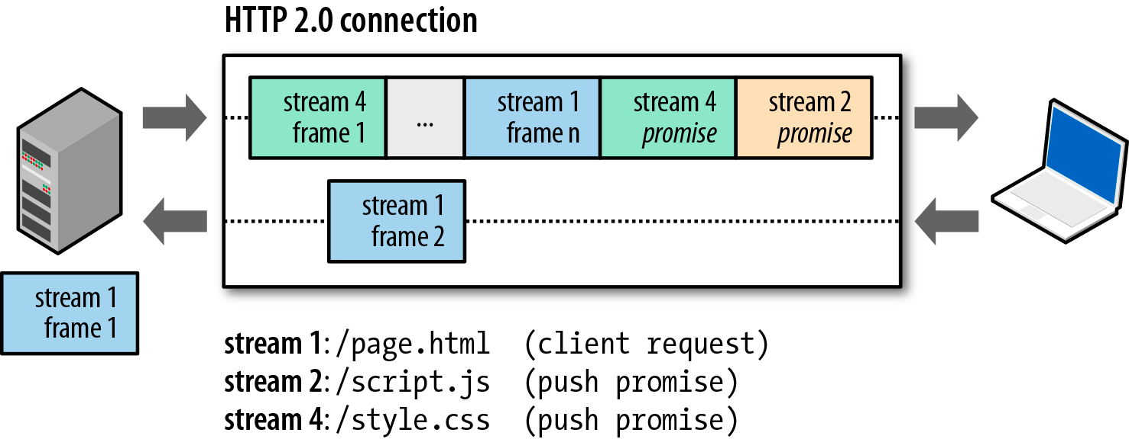
HTTP/2: SERVER PUSH
One request, multiple responses.
Push redirects, cache invalidations… lots of new and exciting possibilities!
Notes:
NOTE: Stress that this is an industry standard (MRC).

Slide 14
DEMO: HTTP/2
http://www.http2demo.io/

Slide 15
2. RUNTIME
Notes:
https://github.com/lukehoban/es6features

Slide 16
RUNTIME
JavaScript

Slide 17
RUNTIME
JavaScript
Virtual Machine

Slide 18
RUNTIME
C/C++ etc.
JavaScript
Virtual Machine

Slide 19
RUNTIME
C/C++ etc.
JavaScript
ASM.js
Virtual Machine

Slide 20
RUNTIME
C/C++ etc.
JavaScript
Web
Assembly
Virtual Machine

Slide 21
DEMO: WebAssembly & ASM.js

Slide 22
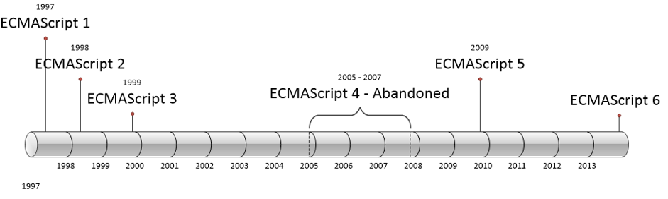
ECMASCRIPT 2015, 2016…

Slide 23
ES2015: CLASSES
class SkinnedMesh extends THREE.Mesh {
constructor(geometry, materials) {
super(geometry, materials);
this.idMatrix = SkinnedMesh.defaultMatrix();
this.bones = [];
this.boneMatrices = [];
//...
}
update(camera) {
//...
super.update();
}
get boneCount() {
return this.bones.length;
}
set matrixType(matrixType) {
this.idMatrix = SkinnedMesh[matrixType]();
}
}

Slide 24
ES2015: ARROW FUNCTIONS
//var odds = evens.map(function(v){ return v + 1; });
var odds = evens.map(v => v + 1);
var nums = evens.map((v, i) => v + i);
nums.forEach(v => {
if (v % 5 === 0) {
fives.push(v);
}
});

Slide 25
ES2015: TEMPLATE STRINGS
// Multiline strings
`In JavaScript this is
not legal.`
// String interpolation
var name = "Bob", time = "today";
var str = `Hello ${name}, how are you ${time}?`;

Slide 26
ES2015: DEFAULT & REST PARAMETERS
function f(x, y = 12) {
// y is 12 if not passed (or passed as undefined)
return x + y;
}
f(3) == 15
function f(x, ...y) {
// y is an Array
return x * y.length;
}
f(3, "hello", true) == 6

Slide 27
ES2015: DESTRUCTING
var a = 1;
var b = 3;
[a, b] = [b, a];
function f() {
return [1, 2];
}
[a, b] = f();
Notes:
https://developer.mozilla.org/en-US/docs/Web/JavaScript/Reference/Operators/Destructuring_assignment

Slide 28
ES2015: LET & CONST
function f() {
{
let x;
{
// okay, block scoped name
const x = "sneaky";
// error, const
x = "foo";
}
// error, already declared in block
let x = "inner";
}
}

Slide 29
JAVASCRIPT: CALLBACKS
var fs = import('fs'); // Bring in the filesystem library
fs.mkdir('test', function (err) {
var f = fs.open('test/newfile', 'w', function (err) {
fs.close(f, function (err) {
fs.unlink('test/newfile', function (err) {
fs.rmdir('test', function (err) {
console.log('Finally finished!!');
});
}
});
});
});

Slide 30
ES2016: ASYNC FUNCTIONS
// Let's create an async anonymous function
async function() {
try {
// Just have to await the promise!
let json = await getJsonAsync("cards.json");
let result = JSON.parse(json);
console.log(result);
} catch (e) {
displayDiv.innerHTML = e;
}
}
Notes:
http://kangax.github.io/compat-table/es7/

Slide 31
DEMO: EcmaScript 2015/2016

Slide 32
3. USER INTERFACE

Slide 33
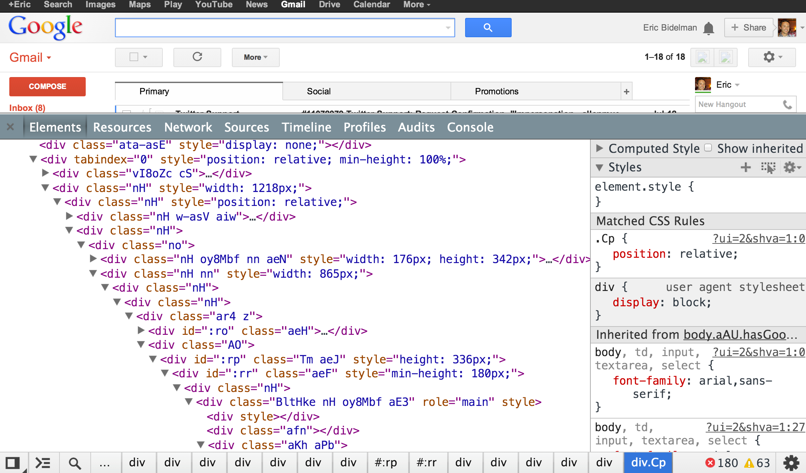

Slide 34

COMPONENT MODEL
<video src=“big_buck_bunny.mp4” controls></video>
Notes:
We has component model. DOM is the framework. Declarative format, attributes (properties), events.

Slide 35
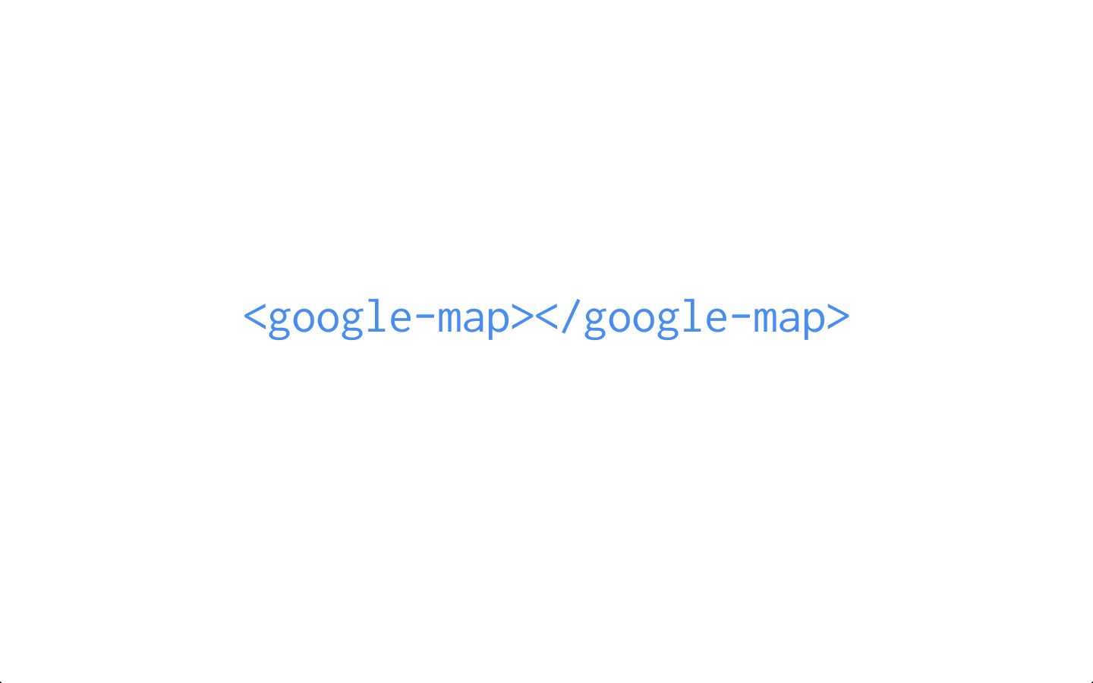
Notes:
In the world of Web Components this becomes a single tag

Slide 36
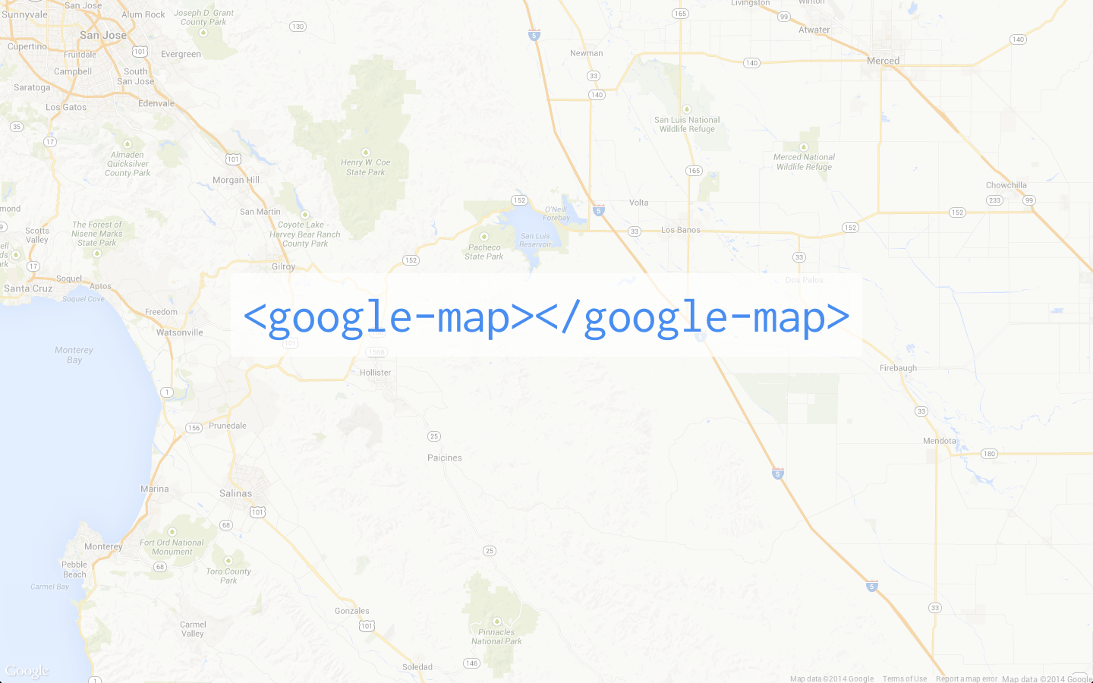
Notes:
Declare the google-map element on your page, and you get a map! Exactly as you expect.
Don’t have to know to style with CSS or use a container or load the library. You just include it on your page, and you’re done.

Slide 37
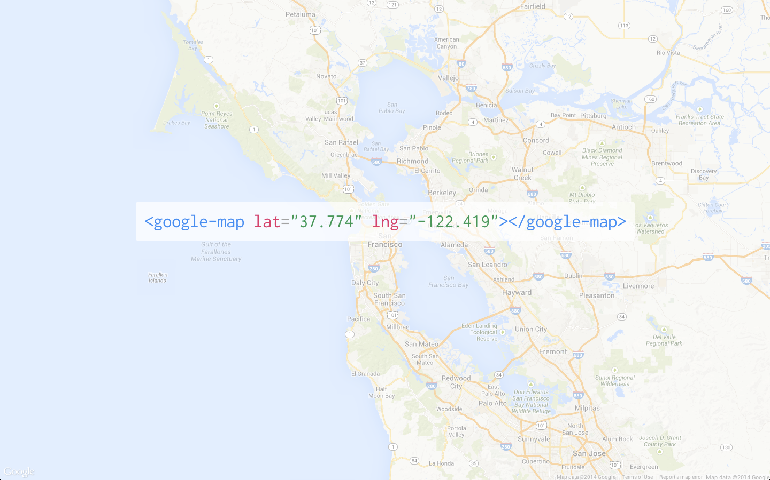
Notes:
Maps is a rich API, it has things that are valuable to us, like centering the map using latitude and longitude. In Web Components we can expose the functionality of the API as an attribute on the element. So I can center the map using a latitude and longitude attribute.

Slide 38
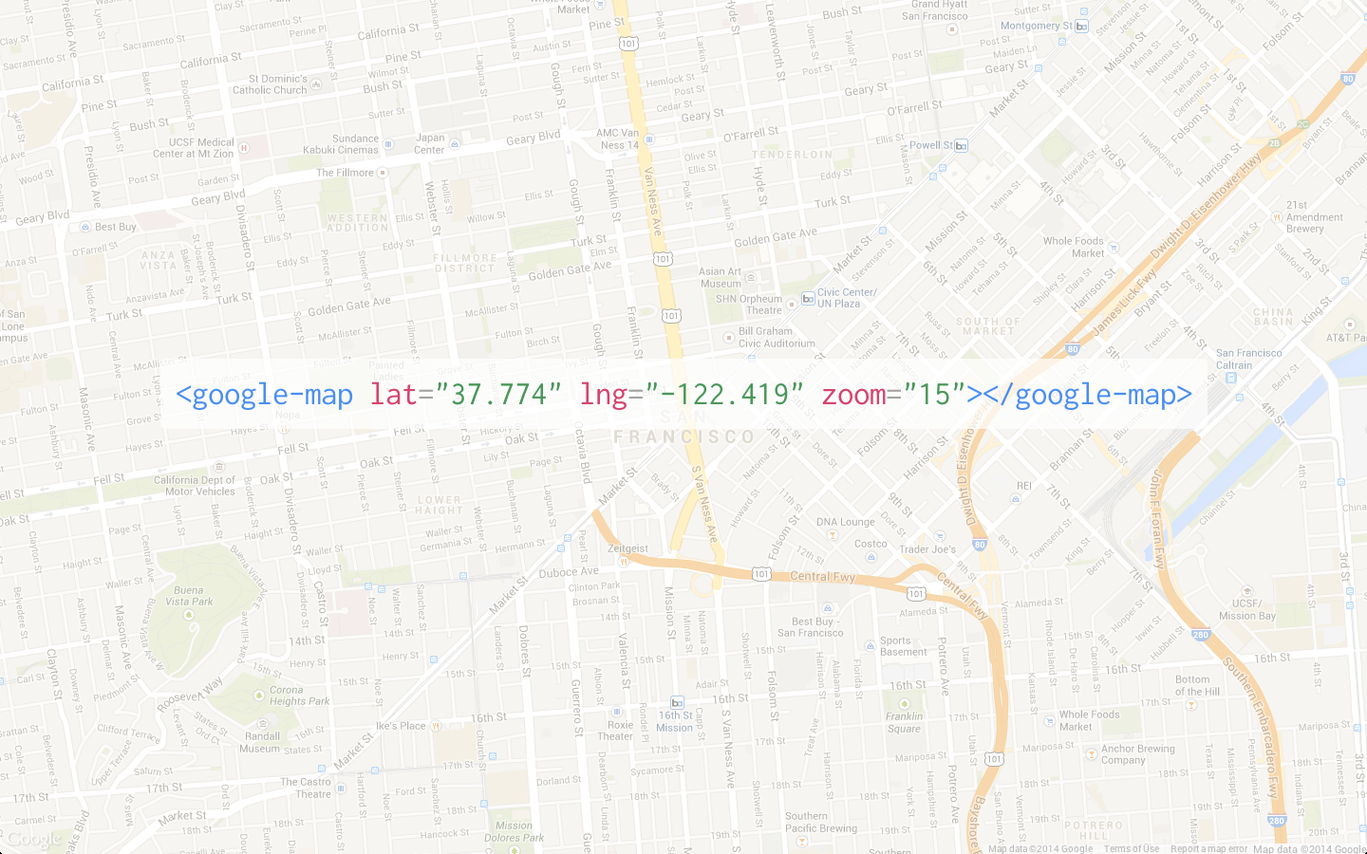
Notes:
I can set its zoom using an attribute.
Underneath the element is calling the maps API under the hood, so you don’t have to do it all yourself.

Slide 39
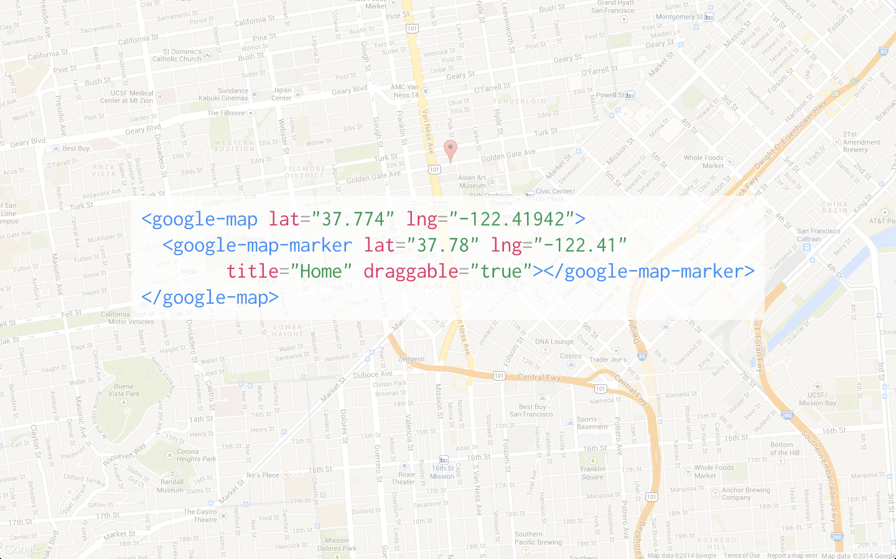
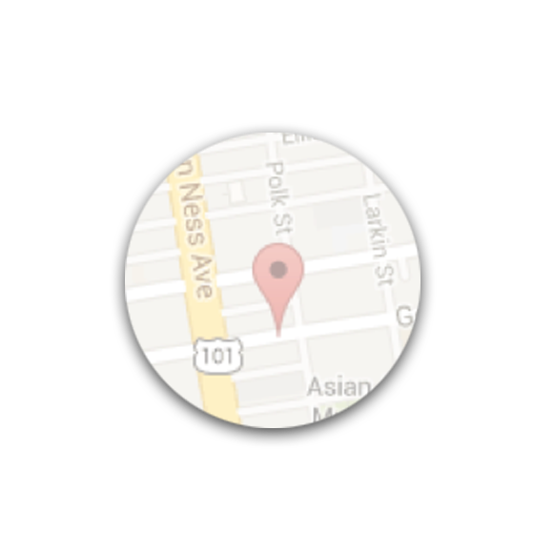
Notes:
And we can make this element composable.
So if I want to include a map marker, I can include a google-map-marker inside of the google-map tag, and it knows what to do with it.

Slide 40

WEB COMPONENTS
Custom Elements
Templates
Shadow DOM
HTML Imports

Slide 41
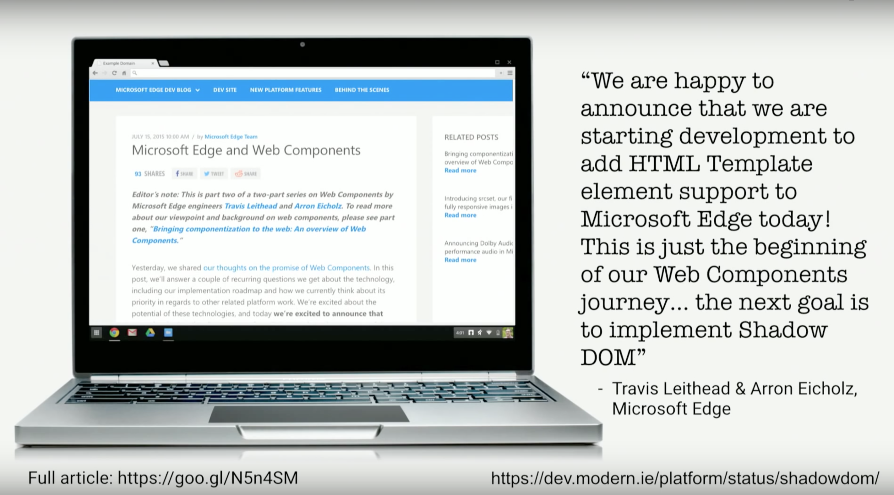

Slide 42
DEMO: Web Components

Slide 43
AGENDA
RUNTIME
NETWORKING
USER INTERFACE
HTTP/2
WebRTC/ORTC
EcmaScript 2015 (ES6)
WebAssembly/ASM.js
Web Components

Slide 44
Questions?
Sergey Pugachev
@spugachev

